Slide 1
Predicting Water Potability Using Machine Learning : Ensuring Safe Drinking
Department of Artificial Intelligence, Korea University
The master's course
Park Geon

Slide 2
I. Project Title
PureWater🧺
: Predicting Water Potability Using Machine Learning

Slide 3
II. Project Introduction
Goal
Develop a machine learning model to predict water potability based on various water quality indicators
Motivation
Public Health Improvement
Access to clean drinking water is a fundamental right for all and a critical aspect of public health. However, many regions still struggle to access safe drinking water.
Environmental Protection
Water pollution is closely linked to environmental degradation, and contaminated water can cause severe harm to both humans and natural ecosystems.
Sustainability
The causes of pollution and water quality vary across regions, necessitating tailored management strategies that are adapted to the specific water characteristics of each area.

Slide 4
III. Dataset Description
Water Potability Dataset
Training Dataset
Composed of 1,608 samples. This dataset is used to train the machine learning model. The model learns the relationship between various water quality indicators and potability during this stage.
Validation Dataset
Composed of 201 samples. This set is used to evaluate model performance during training, allowing for tuning of hyperparameters and preventing overfitting. It helps monitor the model’s generalization performance and adjust the learning process accordingly.
Test Dataset
Composed of 202 samples. After the model is fully trained, this set is used to assess the final performance of the model. It provides an evaluation of how well the model predicts water potability in real-world scenarios.

Slide 5
III. Dataset Description
Dataset Composition
Name | Description
Ph | Measures the acidity or alkalinity of water
Hardness | Indicates the concentration of calcium and magnesium salts
Solids | Represents the concentration of dissolved substances
Chloramines | Compounds formed for water disinfection
Sulfate | Naturally occurring compound in geological formations
Conductivity | Measures water's ability to conduct electricity
Organic Carbon | Indicates the total carbon from organic compounds
Trihalomethanes | Byproducts of chlorine-treated water
Turbidity | Indicates water cloudiness due to suspended solids
Potability | Binary variable indicating whether the water is safe or unsafe

Slide 6
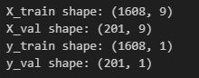
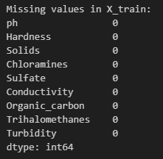
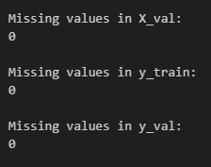
IV. Model
Load train, validation datasets
Check for missing values in the datasets

Slide 7
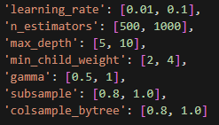
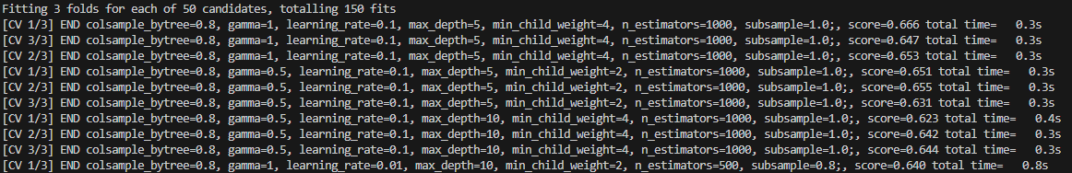

IV. Model
Set up the parameter grid and Initialize the XGBoost Classifier
RandomizedSearchCV and Fit the model
Parameters | Learning rate | N estimators | Max depth | Min child weight | Gamma | Subsample | Colsample bytree
Values | 0.01 | 500 | 5 | 2 | 0.5 | 0.8 | 0.8
 | 0.1 | 1000 | 10 | 4 | 1 | 1 | 1

Slide 8

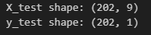
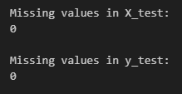
IV. Model
Best estimator parameter
Load the test dataset
Check for missing values in the test dataset
Parameters | Learning rate | N estimators | Max depth | Min child weight | Gamma | Subsample | Colsample bytree
Values | 0.01 | 1000 | 10 | 4 | 1 | 1.0 | 1.0
Validation Accuracy
0.6965

Slide 9
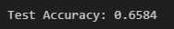
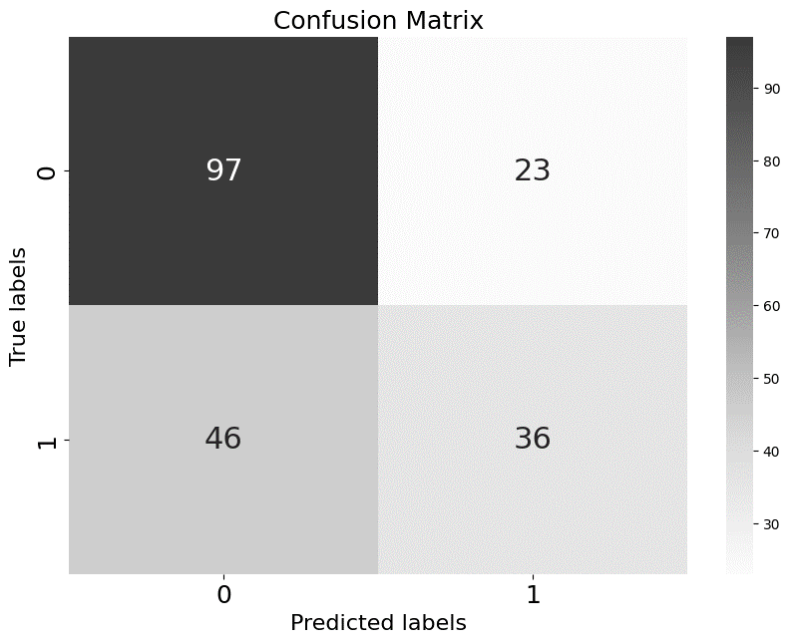
IV. Model
Evaluation of the model for test data
Calculate the confusion matrix
Test Accuracy
0.6584

Slide 10
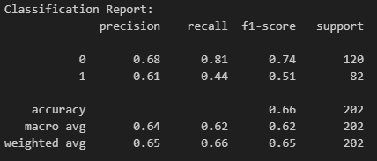
IV. Model
Classification report for each class

Slide 11
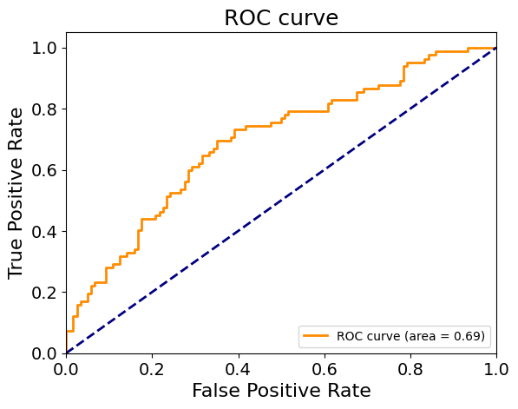

IV. Model
Predict probabilities for the test set and Calculate the ROC AUC score
ROC AUC Score
0.6944

Slide 12
Thank you
(geonpark@korea.ac.kr)

